Slide 1
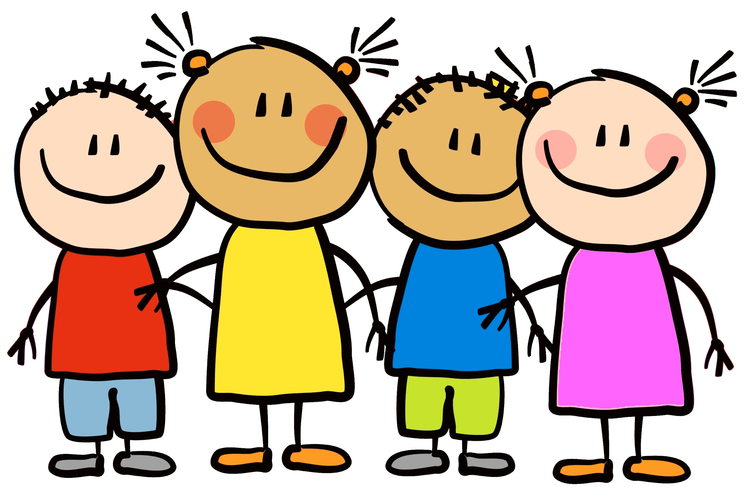
Welcome to Curriculum Night!
Updates in Reading and Math
1st Grade
Karla Endemann
Judy Kinsela
Judy Kinsela
Bonnie Wilkie
Angela Taylor

Slide 2
2018-19 Changes to TRC Testing (Reading3D)
These changes were made by NCDPI at the state level (North Carolina Department of Public Instruction) and were to be implemented this school year
All public elementary schools in the state are required to follow
- The main change is that the books we use to assess students for the 3 benchmarks have changed. The state used to use a set called Rigby. We now use a set called Atlas. We have a beginning of year, middle of year, and end of year benchmark. We are currently in the middle of year testing window.

Slide 3
2018-19 Changes to TRC Testing (Reading3D)
With changing the books from Rigby to Atlas, we are seeing levels drop across the school, district, and state for students. This is because the books are more difficult and the oral comprehension questions that follow the book are also more rigorous and difficult for students compared to the former Rigby.
The state also mandates that at the end of the year, classroom teachers of record are NOT allowed to assess their own students. This is to ensure a valid testing environment/score. We elected at MPTS to also do this for the midyear. We are ensuring that the same teacher (although not the classroom teacher) will assess the student at both middle and end of year. This allows them to build a relationship and ensure an effective and most comfortable testing environment before the end of the year score. (This is the score that determines growth and where a student ends at the end of the year.)

Slide 4
2018-19 Changes to TRC Testing (Reading3D)
As a district and as a school, we continue to work to ensure that our daily teaching in the classroom will best prepare students to be successful on their end of year testing. This includes looking at our oral comprehension questions, as well as written comprehension and the text selection choices that we are making for our students.

Slide 5
Balanced Literacy in 1st Grade
There are five basic components of a “balanced literacy” program; guided reading, shared reading/interactive read aloud, independent reading, word work, and writing.
Students in 1st grade are engaged in each of these components through Word Work, Writer’s Workshop, and Reader’s Workshop.

Slide 6
Types of Questions
-Main Focus- HOW and WHY questions

Slide 7
Word Work
Phonics + Spelling + Word Sorts + Vocabulary Instruction = WORD WORK
Word Work allows children to gain a general understanding of English spelling. They learn how to work with words through hands on activities. They are actively engaged in completing word sorts, building words, and manipulating words. Students will discover generalizations about spelling, not just spelling rules. Children also learn the patterns and conventions needed to read and spell. Word Work increases children’s specific knowledge of not only the spelling of word but also the meaning.

Slide 8
Phonics & Spelling
Phonics instruction involves the relationship between sounds and their spellings. The goal is to teach children the most common sound-spelling relationships found in the English language. This explicit instruction enables students to decode words when reading and correctly spell words when writing.

Slide 9
Sound Spelling Cards
During Word Work students are engaged in phonemic awareness, blending, segmenting, spelling, and sorting activities. Children frequently reference the sound spelling cards during Word Work activities.
The top of the card shows an image that reminds students of the sound.
The bottom of the card shows multiple spellings for the sound.
Vowels are shown in red
A blank indicates the need for another letter (consonant or vowel)
A green box indicates a vowel is used in the spelling

Slide 10
Blending
To become proficient readers, students must learn to blend individual sounds smoothly together in words without choppy pauses between sounds.
jump drive cartoon

Slide 11
Reader’s Workshop
Reader’s Workshop focuses on the strengths and needs of each individual student through differentiated instruction. Children are explicitly taught strategies to become more skillful at reading and comprehending a variety of texts. Students are given time and choice of what to read on their individual level, as well as opportunities to read and share with their peers.

Slide 12
The Model
Mini Lesson
Students are actively engaged in…
Strategy/Craft/Genre lesson
Read Aloud
Comprehension kills practice
Turn and Talk
Independent Reading
Students read, read, read
Teacher holds guided reading groups
Share
Students share and reflect on their reading

Slide 13
Guided Reading
Guided Reading groups are held during Reader’s Workshop. Teachers work with a small group of students who are on the same reading level while the rest of the class reads independently. Guided reading lessons focus on using the strategies taught during mini lessons to read with accuracy and understanding.

Slide 14
The Strategies

Slide 15
What you need to know about comprehension questions
Increasing the rigor in students’ oral and written comprehension
The difference in the students’ answers are the details.
Providing details takes deeper thinking and extra time/effort from the students.

Slide 16
Written Comprehension
Students reading at or above Level F are required to answer written comprehension questions. The written comprehension questions become more difficult as the level of text increases. As you can imagine, demonstrating understanding through written response is one of the most difficult skills for children to learn. The written comprehension questions are scored using the following scale:
0 No understanding: the response is completely incorrect, irrelevant to the question, or missing
1 Minimal understanding: minimally addresses the demands of the question and uses minimal information to show understanding of the text in relation to the question
2 General understanding: partially addresses the demands of the question and uses general information to clarify or extend understanding
3 Complete understanding: addresses the demands of the question and effectively uses detailed information to clarify or extend understanding

Slide 17
Goldilocks and the Three Bears Oral Comprehension
Question Examples
What is a character trait that describes Goldilocks?
What do you think Goldilocks will do the next time she knocks on someone’s door and they do not answer?
What was the surprise in the book?
Why do you think the three bears never saw Goldilocks again?

Slide 18
Goldilocks and the Three Bears Oral Comprehension
Read the text and then I am going to ask you to tell me what you remember, starting at the beginning.
Failing Answer
There was a little girl and there were some bears and she walked in the forest.
Passing Answer
A little girl named Goldilocks was playing in the woods and she smelled something yummy. She was hungry so she followed the smell. The smell was coming from a little house and she knocked on the door but no one was home. She went in anyway and ate some porridge. The biggest bowl was to cold, the middle bowl was too hot, but the littlest bowl was just right so she ate it all. Then she saw chairs in the living room, the biggest chair was too big, the medium size chair was too soft, and the tiny chair was just right, until she broke it. Then she decided to lay down but the biggest bed was too hard, the medium size bed was too soft, and the littlest bed was just right and she fell asleep. Then the bears came home and saw muddy foot prints. They saw someone had been eating the porridge, sitting in their chairs, sleeping in their beds, and she was still there. Goldilocks woke up and ran away screaming.

Slide 19
Goldilocks and the Three Bears Written Comprehension
How did the three bears find out Goldilocks was in their house? Use parts of the story in your answer.
Failing Answer
They saw her.
Passing Answer
When the three bears came home from their walk on page 17, they saw somebody had been in their house because their porridge was eaten. Then on page 19 they saw their chairs had been sat in, so when they heard the noise from upstairs they went up to the bedroom and saw her sleeping in bed, on page 21.

Slide 20
Goldilocks and the Three Bears Written Comprehension
List two settings in the story. Tell one or more things that happen in each place. Use parts of the story in your answer.
Failing Answer
Goldilocks went for a walk and she went into the bears’ house.
Passing Answer
The first setting was in the woods. On page 3 Goldilocks was taking a walk through the woods and smelled something yummy. On page 5 she found a house in the woods and knocked on the door.
The second setting was inside in the bears’ house. She ate their porridge, sat in their chairs, and slept in the bed. The bears came home and found her.

Slide 21
Goldilocks and the Three Bears Written Comprehension
In the story Goldilocks says “Mmmmmm”. What does that sound tell us about Goldilocks? Use parts of the story in your answer.
Failing Answer
She was hungry.
Passing Answer
When Goldilocks says, “Mmmmmmm”, it means she thinks the porridge smells good and that it will taste good because on page 9 she is licking her lips like she can’t wait to eat it and she says the porridge is perfect.

Slide 22
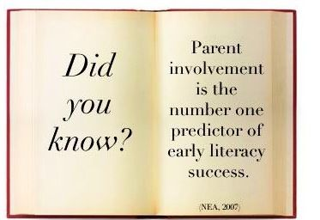
Ways to Help
Read with your child every night.
After reading, discuss what was read and ask your child questions.
Practice sight words with your child on a regular basis.
Use RAZ Kids!

Slide 23
RAZ Kids
Students can listen to and read books, take comprehension quizzes, and even record themselves reading.

